Slide 1

New Hire Processing
Certified Employees

Slide 2








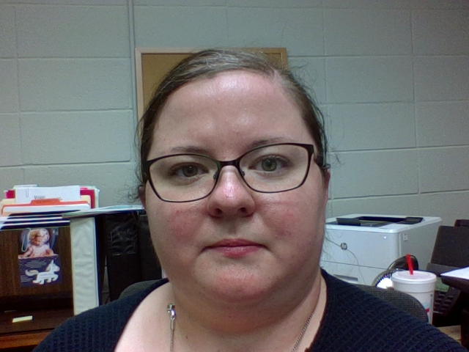
Welcome to
Sumner County Schools!!!
We are delighted to have you!!!

Slide 3

Sumner County
Schools
In Operation since 1873
49 Schools
  1 Middle College High School,
  1 Middle Technical College High School,
  7 regular high schools,
  1 virtual high school,
  11 middle schools,
  24 elementary schools,
  5 STEM (Science, Technology, Engineering and Math) elementary schools,
  1 STEM Middle School
  1 academic magnet school and
  1 alternative/zero tolerance school.
Over 5,000 employees
Over 29,000 students
Overview of Our District

Slide 4
Shared Vision
Sumner County Schools is a collaborative culture of high performing students, teachers, and school communities.

Slide 5
Mission Statement
Sumner County Schools commits to growing learners who are college and career ready through quality instruction, effective use of resources, building a collaborative culture and strong leadership.

Slide 6
Our Beliefs
We believe in a safe & supportive environment that holds high expectations for students & staff.
We believe in students, parents, school employees, & community members working collaboratively & respectfully as partners in the education of all learners to develop prepared graduates.
We believe in an inclusive culture that embraces diversity, gives equal access to each child, promotes responsibility, & supports positive self-esteem.
We believe that by engaging minds & developing character, we will prepare students to become competent, employable citizens.
We believe in the use of data to continually assess our decision making to ensure each student has the opportunity to achieve at proficient & advanced levels.
We believe in implementing policies & procedures that focus on achieving the educational goals of our school system.

Slide 7

Please take time to review the policies contained in this handbook.
In the event of a discrepancy among any of the information contained in our orientation materials, the Employee Handbook and the SCS Board Policy, the SCS Board Policy will govern.
The online version of this publication is the governing document; therefore, all printed versions of this document are unofficial copies.
For electronic access please visit www.sumnerschools.org.

Slide 8

HANDBOOK ACKNOWLEDGEMENT
By signing the acknowledgement form, you are stating that you acknowledge receipt of the handbook, and understand and agree that is your responsibility to read and comply with the policies therein.
READ IT!!!

Slide 9


Sexual & Unlawful Harrassment
Sexual and other unlawful harassment is a violation of Title VII of the Civil Rights Act of 1964 (Title VII), as amended, as well as many state laws.
Harassment based on a characteristic protected by law, such as race, color, ancestry, national origin, gender, sex, sexual orientation, gender identity, marital status, religion, age, disability, veteran status, or other characteristic protected by state or federal law, is prohibited.
It is SCS’s policy to provide a work environment free of sexual and other harassment. To that end, harassment of SCS’s employees by management, supervisors, coworkers, or non-employees who are in the workplace is absolutely prohibited.

Slide 10

Definition of Unlawful Harassment.
“Unlawful harassment” is conduct that has the purpose or effect of creating an intimidating, hostile, or offensive work environment; has the purpose or effect of substantially and unreasonably interfering with an individual’s work performance; or otherwise adversely affects an individual’s employment opportunities because of the individual’s membership in a protected class.

Slide 11
Examples of Unlawful Harassment
Unlawful harassment includes, but is not limited to:
epithets; slurs; jokes; pranks; innuendo; comments; written or graphic material; stereotyping; or other threatening, hostile, or intimidating acts based on race, color, ancestry, national origin, gender, sex, sexual orientation, marital status, religion, age, disability, veteran status, or other characteristic protected by state or federal law.

Slide 12

Definition of Sexual Harassment.
“Sexual harassment” is generally defined under both state and federal law as unwelcome sexual advances, requests for sexual favors, and other verbal or physical conduct of a sexual nature where:
• Submission to or rejection of such conduct is made either explicitly or implicitly a term or condition of any individual’s employment or as a basis for employment decisions; or
• Such conduct has the purpose or effect of unreasonably interfering with an individual’s work performance or creating an intimidating, hostile, or offensive work environment.

Slide 13
Examples of Sexual Harassment
• Unwanted sexual advances, whether they involve physical touching or not;
• Sexual epithets, jokes, written or oral references to sexual conduct, gossip regarding one’s sex life, comments about an individual’s body, comments about an individual’s sexual activity, deficiencies, or prowess;
• Displaying sexually suggestive objects, pictures, or cartoons;
• Unwelcome leering, whistling, brushing up against the body, sexual gestures, or suggestive or insulting comments;
• Inquiries into one’s sexual experiences; and
• Discussion of one’s sexual activities.

Slide 14
Complaint Procedure & Anti-Retaliation
Any employee who believes he or she has been subject to or witnessed illegal discrimination, including sexual or other forms of unlawful harassment, is requested and encouraged to make a formal complaint in writing.
Submit complaint to your Principal/supervisor or to Human Resources.
No reprisal, retaliation, or other adverse action will be taken against an employee for making a complaint or report of discrimination or harassment or for assisting in the investigation of any such complaint or report.
Any suspected retaliation or intimidation should be reported immediately to your principal/supervisor or Human Resources.

Slide 15


Alcohol & prescription drugs misuse & illegal drugs WILL NOT BE TOLERATED.
Employees must be fit for duty.
Any employee violating this policy is subject to discipline, up to and including termination, for the first offense.
Smoking is prohibited at any time on SCS property, in all buildings as well as vehicles, owned, leased or operated by the district.

Slide 16

Sumner County Schools prohibits the possession of weapons on its property at all times, including parking lots or district vehicles.
Additionally, while on duty, employees may not carry a weapon of any type.
The district reserves the right to inspect all belongings of employees on its premises, including briefcases, purses and handbags, gym bags, and personal vehicles on school or district property.
Any employee violating this policy is subject to discipline up to and including dismissal for the first offense.

Slide 17

Reporting Child Abuse & Neglect
Tennessee Code Annotated 37-1-403 requires all persons to report suspected cases of child abuse or neglect. “Any person who has knowledge of or is called upon to render aid to any child who is suffering from or has sustained any wound, injury, disability, or physical or mental condition shall report such harm immediately if the harm is of such a nature as to reasonably indicate that it has been caused by brutality abuse, or neglect or that, on basis of available information, reasonably appears to have been caused by brutality, abuse, or neglect.”
Sumner County Schools requires all employees to use the Child Abuse Intake Form to immediately report concerns of child abuse or neglect. This form details the procedures to be followed and should be available in the counseling offices of all schools.

Slide 18




Social Media Acceptable Use
Employees should set appropriate boundaries between personal and public online behavior, understanding that what is private in the digital world often has the potential of becoming public, even without knowledge or consent. It is recommended that employees carefully review the privacy settings on any social media accounts and exercise good judgment when posting content and information on such sites.

Slide 19

Employees arrested or convicted of any criminal statute, must inform SCS within five (5) days.

Slide 20
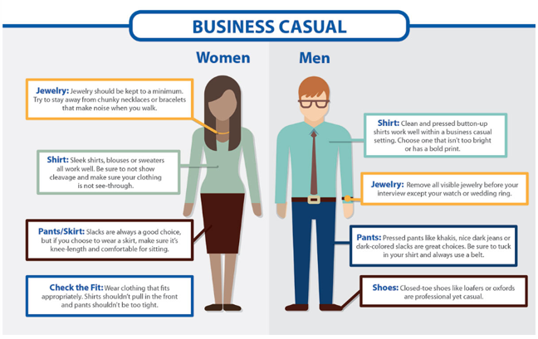
Dress Code & Grooming
Exact Dress Code is Determined by Your Principal
Be professional. Use Common Sense!

Slide 21
Disciplinary Action
In order to sustain SCS’s high educational standards and community relations, the district tries to address disciplinary problems in an efficient, fair and timely manner.
Discipline for performance and behavioral problems may range from verbal warnings to termination, as determined by the Director of Schools, within School Board Policy and Tennessee Rules and Regulations.
The objective is, where possible, to correct performance and discipline problems proactively to achieve positive results or coaching for success while protecting students, SCS and its employees

Slide 22
Voluntary Separation From Employment
Certified personnel are under one-year contracts and should attempt to honor the contract by completing the year of service. When in the event a resignation is the only viable option for the employee and/or the school system, the director of schools may waive the ending of year employment requirement for justifiable reasons.
Employees who provide the requested 30-day notice will be considered to have resigned in good standing and generally will be eligible for rehire. If an employee leaves SCS, he/she will be treated as a new employee including but not limited to fingerprinting and processing.
In the event an employee voluntarily terminates without submitting written notice, the immediate supervisor will have the authority to terminate an employee on the basis of failure to report to the work-station and TN Licensure will be notified as required by law.

Slide 23

Employee Badge
Wear it in a visible location anytime you are on
SCS property.
Contact Human Resources
for a replacement if needed.
You can get into district
sporting events FREE!!!

Slide 24
Change of Information
Name
Address
Telephone Number
Personal email
Marital status
Birth or adoption of child
Must submit to Human Resources, in writing, on the designated form.
Contact Jennifer Runion for further information:
Ph: 615-451-5207 email:jennifer.runion@sumnerschools.org
For name changes: A new social security card must be presented to Human Resources AND
You must change your name with the Tennessee Department of Education licensing board through TN Compass.
You should also make sure your name and information stays up to date in your application, which remains active for transfers, endings, etc.

Slide 25
EMAIL ADDRESS
All employees are issued an email account upon hire for school use.
Please note that all required training and benefit communications will be sent to this SCS email account.
Employees should follow up with their supervisor or principal for login information.

Slide 26

Public School Works is the mandatory training system for all district employees, no matter the position. All new employees are required to complete this training within the first 30 days of employment and thereafter annually.
These online trainings cover topics such as blood borne pathogens, suicide awareness, and sexual harassment.
A link will be sent to your SCS email account. You have 30 days from your start date to complete them.
Training should be completed while you are on the clock.
Questions?: Contact Marla Pike, Training Coordinator email:marla.pike@sumnerschools.org phone: 615-230-6745

Slide 27


Employee Self Service (ESS)
https://sumnerschoolstn.munisselfservice.com/login.aspx
Access your direct deposit stubs
View time off accruals
Get W-2

Slide 28

Frontline (Aesop) Absence Management
Enter absences so substitutes can pick up for coverage.
Your school’s bookkeeper or attendance clerk can help if you have questions.

Slide 29
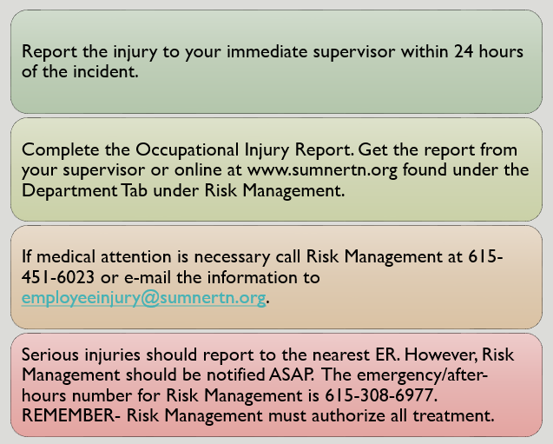
What Do I Do
If Injured
on the Job?
**Don’t forget!!!
ALL injuries must be reported within 24 hours!!!

Slide 30

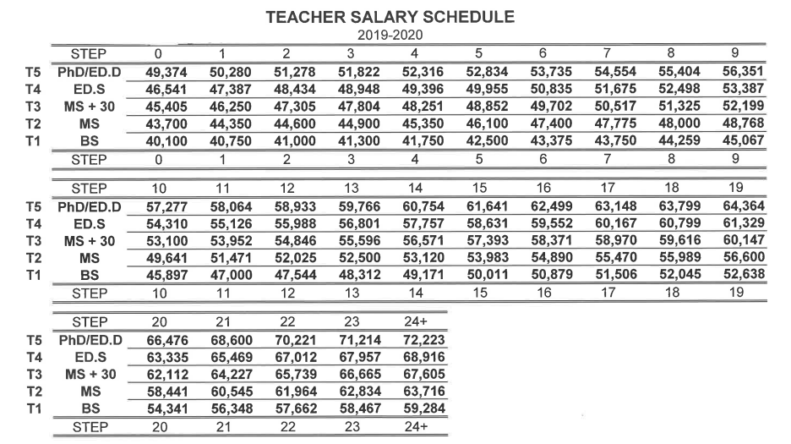
**Payday is monthly on the 15th.**
Salary
How is my salary determined?
Position Type
Degree Level
Years of Experience

Slide 31

Paid Time
Certified instructors are paid for
180 instruction days,
ten (10) days of scheduled holidays,
five (5) in-service days,
one (1) day for parent-teacher conference, and four (4) days designated by the local board.

Slide 32


Time Off
Holidays: 10 preselected holidays
Personal Leave: 1 day for each semester employed. All unused personal days converted to sick leave at end of each fiscal year. (July-June)
Sick Leave: earned at the rate of 1 day per month worked with no limit on accumulation.
Bereavement Leave: 2 days per year may be taken. If the deceased is a spouse, child, grandchild, parent, parent-in-law, sibling, sibling-in-law, or grandparent of the employee, the employee may take an additional 3 days. The deceased must be identified on a leave form.
Jury Duty/Court Appearance: any fees or remuneration the employee receives shall be turned over to SCS.
Time Off for Voting: If you will not have reasonable time out of working hours to vote, contact your supervisor to discuss options no later than noon on the day before the election. Early voting is recommended.

Slide 33
Family & Medical Leave (FMLA)
Sumner County Schools complies with the federal Family and Medical Leave Act (FMLA) and Tennessee and Medical Leave Act (TMLA), which requires employers to grant 12 weeks (16 weeks for birth/adoption) of unpaid, protected leaves of absence to qualified workers for certain medical and family-related reasons.
Leave should be applied for after more than 3 consecutive days absent or intermittent/reduced schedule is required by a medical care provider. Please note there are many requirements, qualifications, and exceptions under these laws, and each employee’s situation is different.
Employees may not take leave and work another job as employment with SCS will be terminated. Contact the Human Resources Department to discuss options for leave.

Slide 34
Military Leave
Sumner County Schools supports the military obligations of all employees and grants leaves for uniformed service in accordance with applicable federal and state laws. Any employee who needs time off for uniformed service should immediately notify the Human Resources Department and his/her supervisor, who will provide details regarding the leave. If an employee is unable to provide notice before leaving for uniformed service, a family member should notify the supervisor as soon as possible.
Upon return from military leave, employees will be granted the same seniority, pay, and benefits as if they had worked continuously. Failure to report for work within the prescribed time after completion of military service will be considered a voluntary termination. All employees who enter military service may accumulate a total absence of five (5) years and still retain employment rights.

Slide 35
Attendance
Absenteeism, whether excused or unexcused, is detrimental to daily operations and often causes hardship on co-workers.
If unable to arrive at work on time, or if an employee will be absent, the employee must contact his/her supervisor as soon as possible. One (1) day absent is considered an occurrence and multiple days for the same reason will be charged one (1) occurrence.
Excessive absenteeism (four (4) or more occurrences in a semester) or tardiness or failure to show up or call in for a scheduled shift without prior approval will result in discipline up to and including termination.
If an employee fails to report to work or call in to inform the supervisor of the absence for three (3) consecutive days the employee will be considered to have voluntarily resigned employment.

Slide 36

Benefits
www.sumnerschools.org/benefits

Slide 37





BCBSTN Medical and Prescription Drug Plan
  PPO
  CDHP with HSA Account
  Choice of Two Network Options
  Wellness Option
Dental Coverage
Vision Coverage
Short-Term and Long-Term Disability Benefits
Employee Benefits Assistance Resource
Basic Term Life Insurance with Accidental Death and Dismemberment
Voluntary Term Life with Accidental Death and Dismemberment
Critical Illness and Cancer Insurance
Flexible Spending Accounts
  Medical Reimbursement Account
  Dependent Care Reimbursement Account
Supplemental Retirement Plans including 403b, 457b and 401K plans
Healthcare Bluebook
Sumner County Health Clinics
Employee Assistance Program
Sick Leave Bank
Annual, Personal and Educational Leave
Employee Discounts
Liability Insurance
Occupational Compensation Plan

Slide 38

Loan Forgiveness Options
Teacher Loan Forgiveness Program (TLFP)
Teach full-time for 5 consecutive years in a low-income school or educational service agency, and meet other qualifications.
May be eligible for forgiveness of up to $17,500 on your Direct Subsidized & Unsubsidized Loans & Subsidized & Unsubsidized Federal Stafford Loans.
https://studentaid.ed.gov/sa/repay-loans/forgiveness-cancellation/teacher
Public Service Loan Forgiveness (PSLF)
Make 120 qualifying monthly payments under a qualifying repayment plan while working full-time for a qualifying government or not-for-profit organization.
Forgives the remaining balance on your loan once the 120 payments are made.
https://studentaid.ed.gov/sa/repay-loans/forgiveness-cancellation/public-service#apply
**Criteria are subject to change. Contact Federal Student Aid for the latest information.**

Slide 39


*MANDATORY* Teacher Orientation
PLANS ARE BEING
FINALIZED

Slide 40

Jayme McFadden Human Resources Supervisor-Certified 615-451-5208 jayme.mcfadden@sumnerschools.org
Marla Pike Recruiting/ Training Specialist 615-230-6745 marla.pike@sumnerschools.org
Geni Weatherford Human Resources Specialist-Certified 615-230-6749 geneva.weatherford@sumnerschools.org
Certified Team
Contact us with questions!
We are here for you!

